Slide 1

Hospital Acquired Infections

Slide 2
Definition
Hospital-acquired infections (HAIs) — also known as nosocomial infections —
Infections that patients acquire while receiving treatment for other conditions in a healthcare setting, such as a hospital, clinic, or long-term care facility after 48 hours of admission.
Not present or incubating at the time of admission.
Can also affect healthcare workers.

Slide 3
Nosocomial infections may also be considered either epidemic or endemic.
Endemic infections are most common.
Epidemic infections occurs during outbreaks, defined as an increase above the baseline of a specific infection or infective organism.
Type of nosocomial infection | Simplified criteria
Surgical site infection | Any purulent discharge, abscess, or spreading cellulitis at the surgical site during the month after the operation.
Urinary infection | Positive urine culture (1 or 2 species) with at least 10^5 bacteria/ml, with or without clinical symptoms.
Respiratory infection | Respiratory symptoms with at least two of the following signs appearing during hospitalization: cough; purulent sputum; new infiltrate on chest radiograph consistent with infection.
Vascular catheter infection | Inflammation, lymphangitis or purulent discharge at the insertion site of the catheter.
Septicaemia | Fever or rigors and at least one positive blood culture.

Slide 4
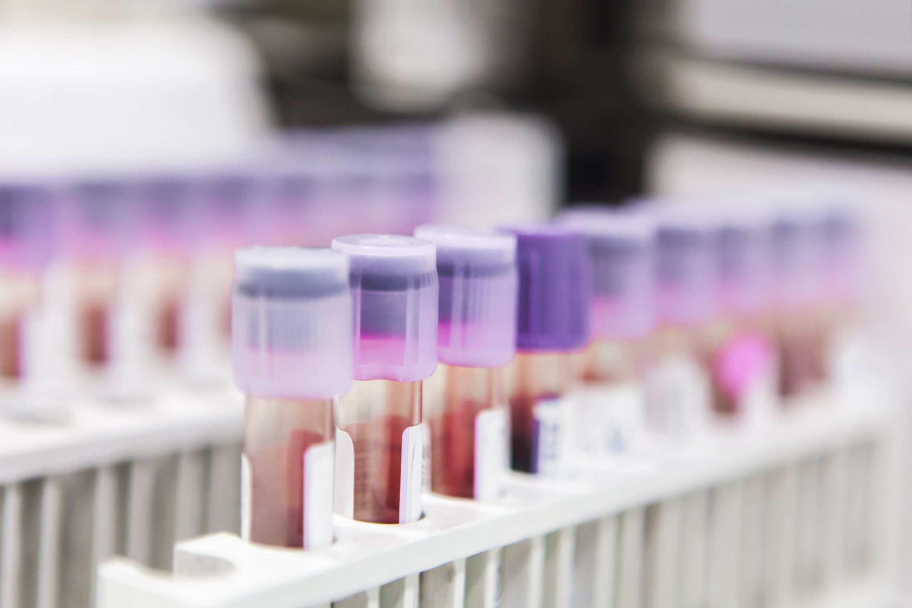
Hospital acquired infections may be considered from 3 angles
Source
Route of spread
Recipient

Slide 5
Source
The source are patient , hospital staff and environment.
PATIENTS: Patient suffering from infectious diseases are potential source of infection.
These cases may be certain Viral infection, Skin infections, Respiratory infections and Urinary tract infections.

Slide 6
B) STAFF:
The hospital staff who come in close contact with patients may often be an important source of cross infection.
Staphylococcus aureus is commonly carried in the nose or on the skin.
Haemolytic streptococci may be carreied in the throat and Salmonella in the gut.
C) ENVIRONMENT:
The hospital environment is laden with microorganisms, and thus is an important source of infection.

Slide 7

Routes of spread:
Direct contact, i.e the organism may be directly transfered from hands of a doctor or a nurse to a susceptible patient.
Droplet infection, eg. droplet released from nose and throat through coughing or sneezing.
Air-borne particles
Release of hospital dust into the air
Through various hospitals procedures, viz, catheterization, intravenous procedures, infected cat gut, dressings, sputum cups, bed pans, urinals etc.

Slide 8
The four most common nosocomial infections are:
Urinary tract infections
Surgical wound infections
Pneumonia
Primary bloodstream infection.
Each of these is associated with an invasive medical device or invasive procedure.
Specific policies and practices to minimize these infections must be established, reviewed and updated regularly, and compliance monitored

Slide 9
Recipients:
All patients in hospitals are potential recipients of cross infection.
Some patients are more susceptible than others, specially those who are seriously ill and those under corticosteroid therapy.
Cross infection is greater in intensive care unit, urological and geriatric ward and special baby care unit.

Slide 10
Preventive Measures
The main preventive measures are :
a) Isolation:
Infectious patients must be isolated.
Patients who are susceptible to infection should not be placed in beds next to patients who are a source of infection.
b) Hospital staff:
Those who are suffering from skin diseases, sore throat, common cold, ear infection, diarrhoea or dysentery and other infectious ailments should be kept away from work until completely cured.
They should be careful about personal hygiene and in regular changes of aprons and outer clothing.

Slide 11
c) Hand-washing:
The most common route of infection is via the hands.
When dealing with patients, hand-washing must be thorough.
When hand-washing with soap and water is not sufficient, a suitable alcohol-based disinfectant must be employed for hand-washing.
d) Dust control:
Hospital dust contains numerous bacteria and viruses. The dust is released during sweeping, dusting and bed making.
Suppression of dust by wet dusting and vacuum cleaning are important control measures

Slide 12
e) Disinfection:
The articles used by the patient as well as patient's urine, faeces, sputum should be properly disinfected.
Proper sterilization of instruments should be enforced.
f) Control of droplet infection:
Use of face masks, proper bed spacing, prevention of overcrowding and ensuring adequate lighting and ventilation are important control measures.

Slide 13
g) Nursing techniques:
Barrier nursing and task nursing have also been recommended to minimize cross infection.
h) Administrative measures:
There should be a hospital “Control of Infection Committee" to formulate policies regarding admission of infectious cases, isolation facilities, disinfection procedures, and in fact all matters relating to control of hospital acquired infection.
Approach | Definition | Key Features | Main Purpose
Barrier Nursing | Infection control using barriers and protocols | PPE, isolation, dedicated equipment, hand hygiene, strict protocols | Prevent infection spread
Task Nursing | Assignment of specific tasks to staff for all patients | Each staff does only certain duties repeatedly; supervised by head nurse; focuses on efficiency | Efficient care delivery

Slide 14
Standard (routine) precautions
Standard precautions should be applied to the care of all patients.
This includes limiting health care worker contact with all secretions or biological fluids; skin lesions, mucous membranes, and blood or body fluids.
Health care workers must wear gloves for each contact which may lead to contamination, and also gown, mask and eye protection where contamination of clothes or the face is anticipated.

Slide 15
Infection | Proven effective | Proven not effective
Urinary tract infections | Limit duration of catheter Aseptic technique at insertion Maintain closed drainage Antiseptic added to drainage bag Antimicrobial-coated catheter Daily antiseptic perineal cleaning | Systemic antibiotic prophylaxis Bladder irrigation or instillation of normal saline antiseptic or antibiotic
Surgical site infections | Surgical technique - Clean operating environment - Staff attire Limiting preoperative hospital stay Preoperative shower and local skin preparation of patient Optimal antibiotic prophylaxis Aseptic practice in operating room Surgical wound surveillance | Fumigation Preoperative shaving

Slide 16
Infection | Proven effective | Proven not effective
Pneumonia | Ventilator-associated: - Aseptic intubation and suctioning - Limit duration - Non-invasive ventilation Others: - Influenza vaccination for staff - Isolation policy - Sterile water for oxygen and aerosol therapy - Prevention of Legionella and Aspergillus during renovations | Digestive decontamination for all patients Changes of ventilator circuit every 48 or 72 hours
Vascular device infections | All catheters: - Closed system - Limit duration - Local skin preparation - Aseptic technique at insertion - Removal if infection suspected Central lines: - Surgical asepsis for insertion - Limitation of frequency of dressing change - Antibiotic-coated catheter for short term | Antimicrobial creams for skin preparation

Slide 17

Considerations for protective clothing include:
Gown: should be of washable material, buttoned or tied at the back and protected, if necessary, by a plastic apron.
Gloves: inexpensive plastic gloves are available and usually sufficient
Mask: surgical masks made of cloth or paper may be used to protect from splashes.

Slide 18

Standard precautions for all patients are as follows:
Wash hands promptly after contact with infective material.
Use no touch technique wherever possible.
Wear gloves when in contact with blood, body fluids, secretions, excretions, mucous
membranes and contaminated items.
Wash hands immediately after removing gloves.
All sharps should be handled with extreme care.

